Slide 1


FinlatiCs PROJECT
HarshIT KUMAR GAUTAM
IIT DELHI

Slide 2

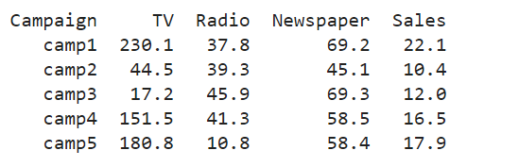
CASe-STUDY-1 : Sales Prediction Dataset
Goal : The goal of the given case study is to predict the Sales from the given data i.e. information about the advertising expenditures of a company on various platforms (TV, Radio, newspapers).

Slide 3
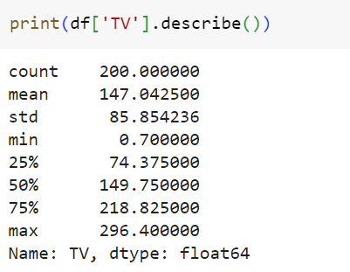
Q1. Average amount SPENT ON TV
We can see the mean value of expenditure in TV is given as 147.04
We can also observe that mean is close to median which is 149.75

Slide 4
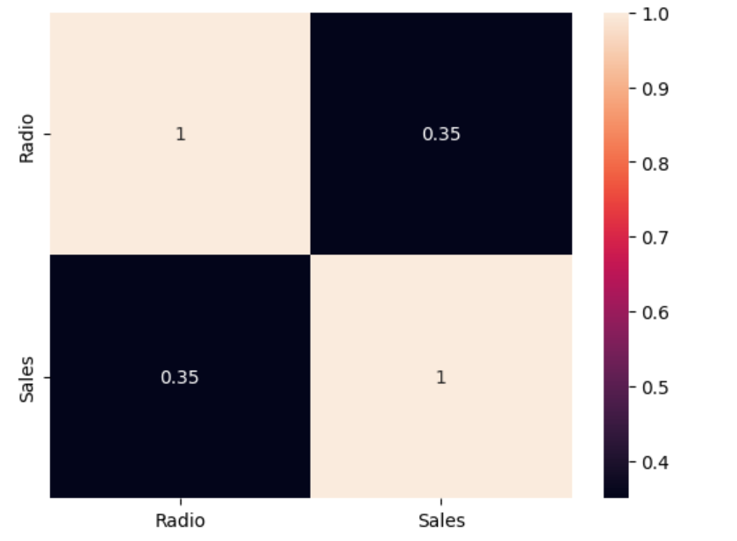
Q2 . correlation between radio and product sales
We can see the correlation between the Radio and the Sales is 0.35
0.35 depicts a very slight positive correlation between the Radio and Sales . Therefore we can assume they are not too much related.

Slide 5
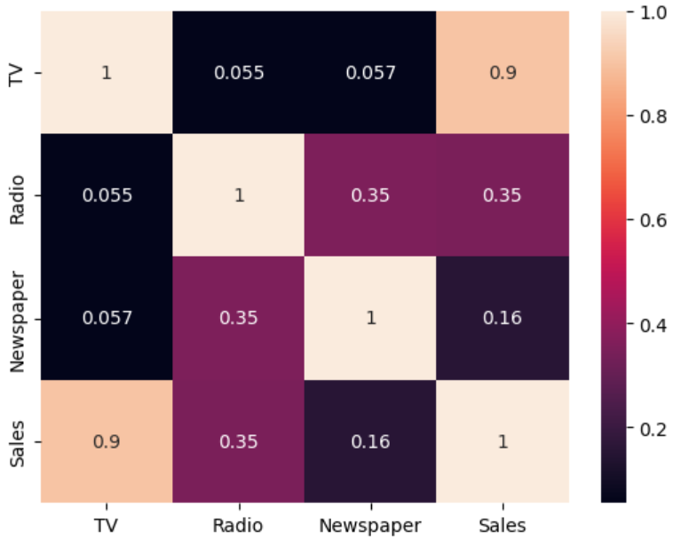
Q3. WHICH medium has the highest impact on sales ?
We can observe the correlation index of Sales w.r.t TV(0.9) , Radio(0.35) and Newspaper(0.16).
As TV has the highest correlation index which is greater than 0.7 , therefore it highly impacts the sales .

Slide 6
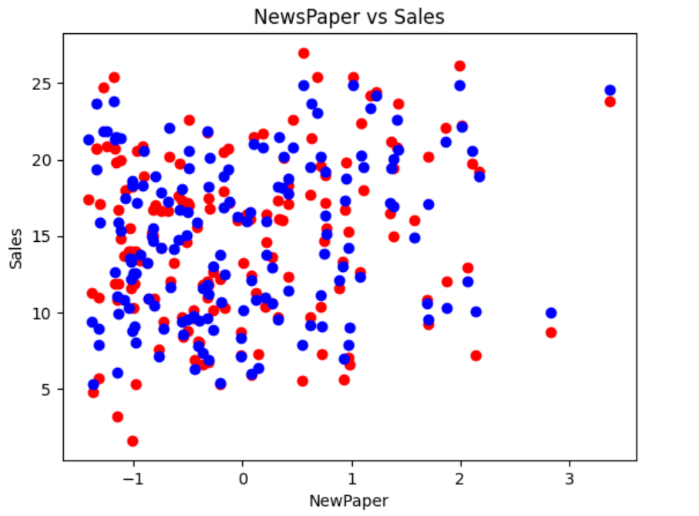
Q4. Linear REGRESSION PLOT ( TRAINED DATA )
Here is the plot of the trained data and the actual training dataset.
Red represents the training data.
Blue represents the predicted data.

Slide 7
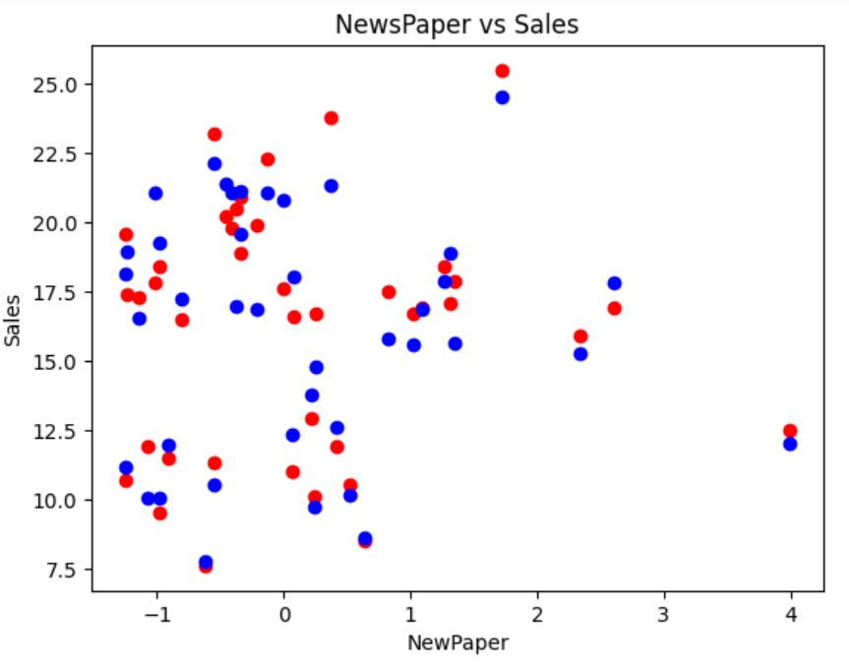
Q4. Linear REGRESSION PLOT ( Testing DATA )
Here is the plot of the trained data and the actual training dataset.
Red represents the testing data.
Blue represents the predicted data.
MSE Loss : 4.61

Slide 8
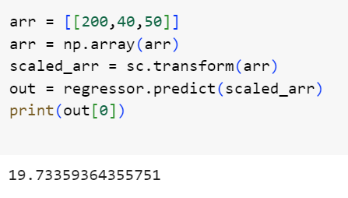
Q5. Sales Prediction for New Dataset
Prediction of Sales for TV($200) , Radio ($40) and Newspaper($50) came out to be $19.73
We can compare it with the sales of first record of the data TV($230.1) , Radio ($37.8) and Newspaper($69.2) is $22.1
As we can see the data almost matches this record and also the result therefore our prediction is in the right direction.

Slide 9
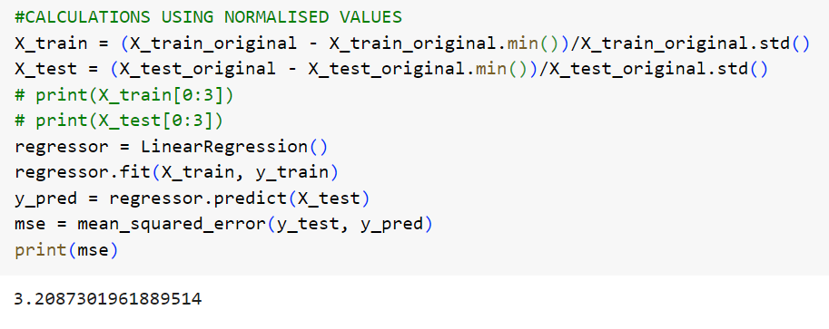
Q6. SHIFTING FROM STANDARDISATION to NORMALISATION
Here we are normalising our training and testing data i.e. between [0,1]
MSE Loss : 3.20
MSE Loss(Standardised) : 4.61
We can clearly see there is less loss in the Normalised version.Therefore it results in a better trained model.

Slide 10
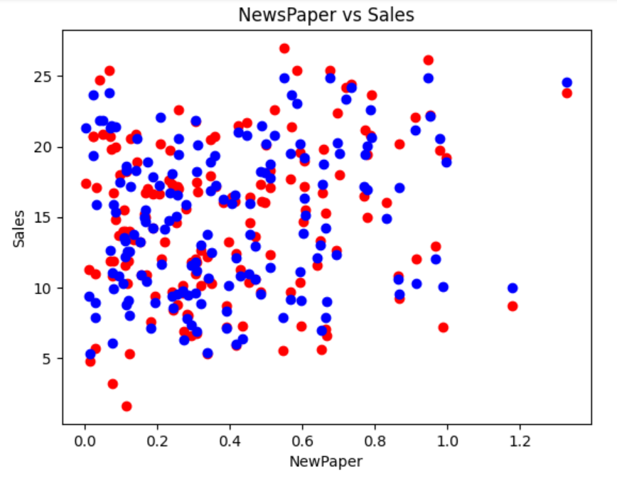
Q6. SHIFTING FROM STANDARDISATION to NORMALISATION
Red dots : trained data
Blue dots: predicted data
We can compare this figure with the previous trained model figure from standardised values.
It is more closer to the actual value than the previous model.

Slide 11
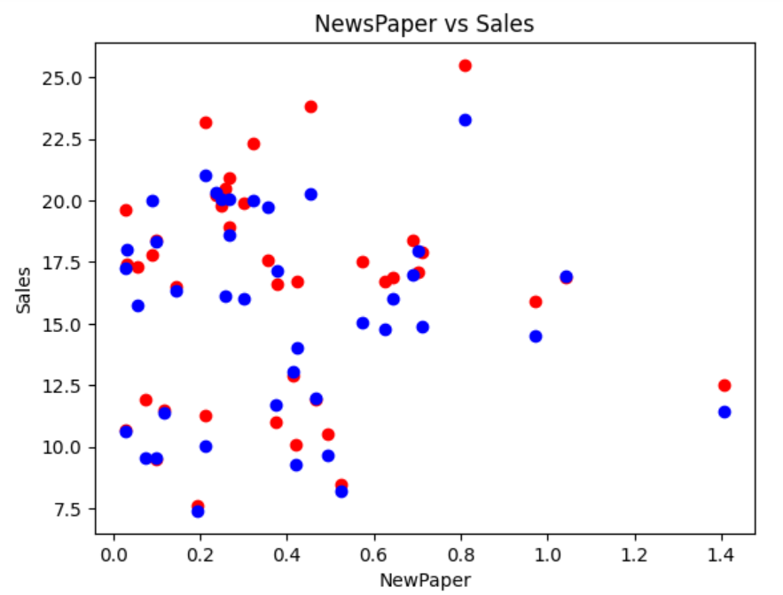
Q6. SHIFTING FROM STANDARDISATION to NORMALISATION
Red dots : testing data
Blue dots: predicted data
We can compare this figure with the previous trained model figure from standardised values.
It is more closer to the actual value than the previous model.

Slide 12
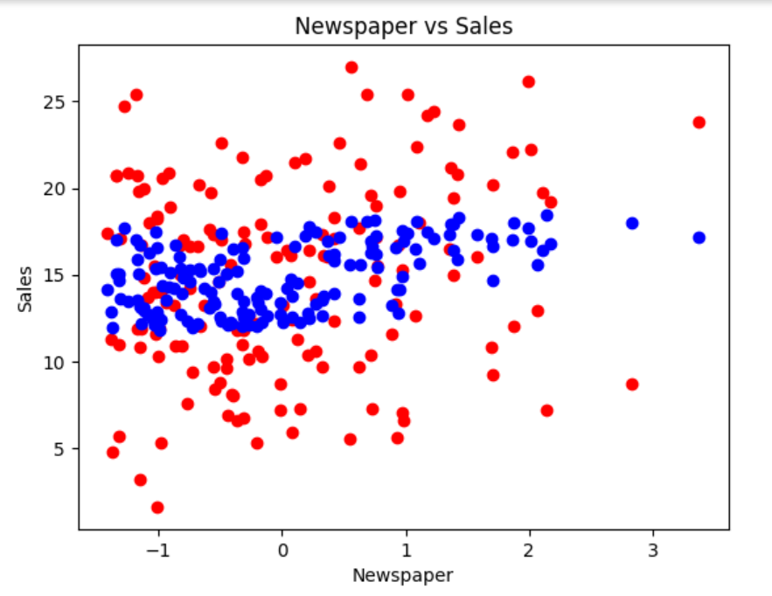
Q7. USING ONLY RADIO , NEWSPAPER AS FEATURES TO TRAIN MODEL
Red dots : training data
Blue dots: predicted data
We can clearly see there is too much deviation between the training and predicted data.

Slide 13
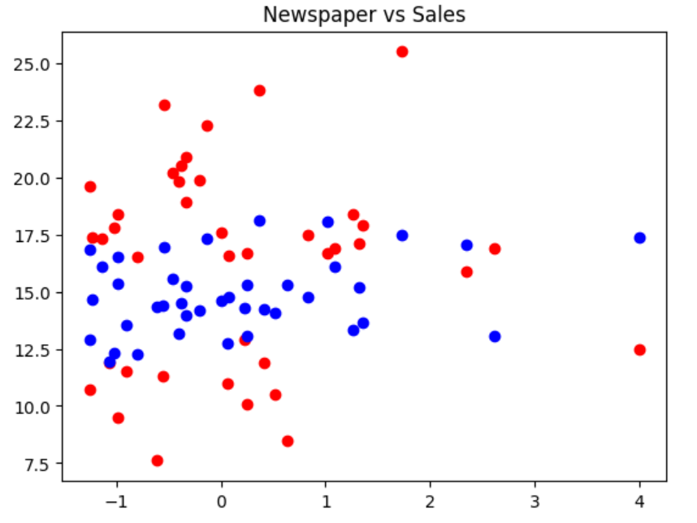
Q7. USING ONLY RADIO , NEWSPAPER AS FEATURES TO TRAIN MODEL
Red dots : testing data
Blue dots: predicted data
We can clearly see there is too much deviation between the training and predicted data.
MSE Loss : 19.07
We can see there are too much losses too.

Slide 14
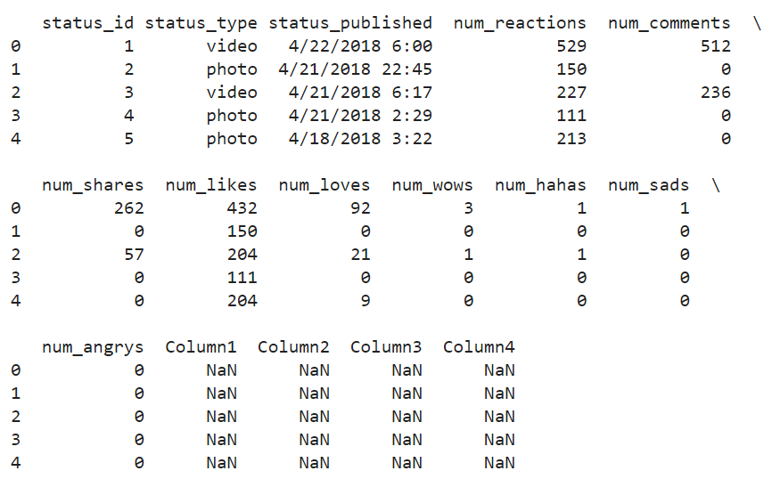
CASe-STUDY-2 : Facebook Live Sellers Dataset
Goal : The goal of the given case study is to predict how many different types of posts are present in the data set by using K-Means Clustering algorithm.

Slide 15
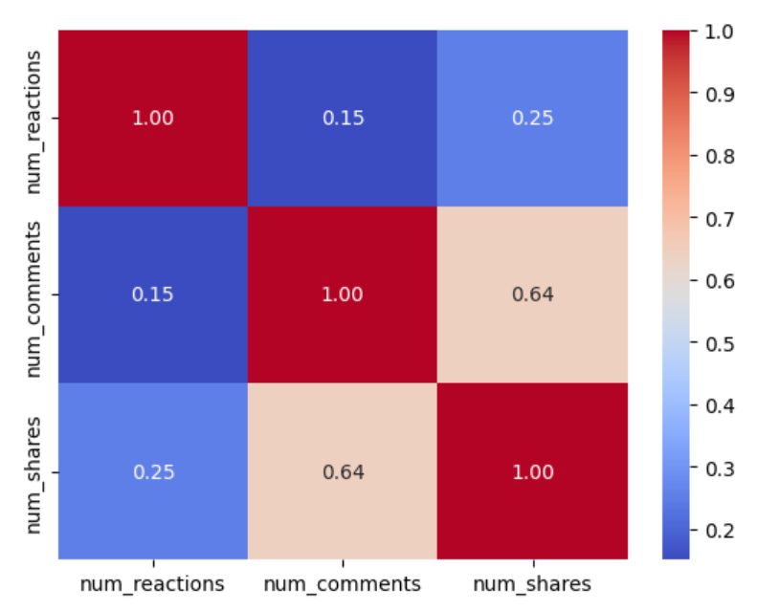
Q1. CoRRELATION BETWEEN NUM_REACTIONS , NUM_COMMENTS and NUM_SHARES
We can see correlation index between num_comments and num_shares is 0.64 . Therefore they are somewhat positively dependent on each other.
An index of 0.15 and 0.25 between num_reactions and num_shares , num_comments depicts a very slight dependence or no dependence .

Slide 16
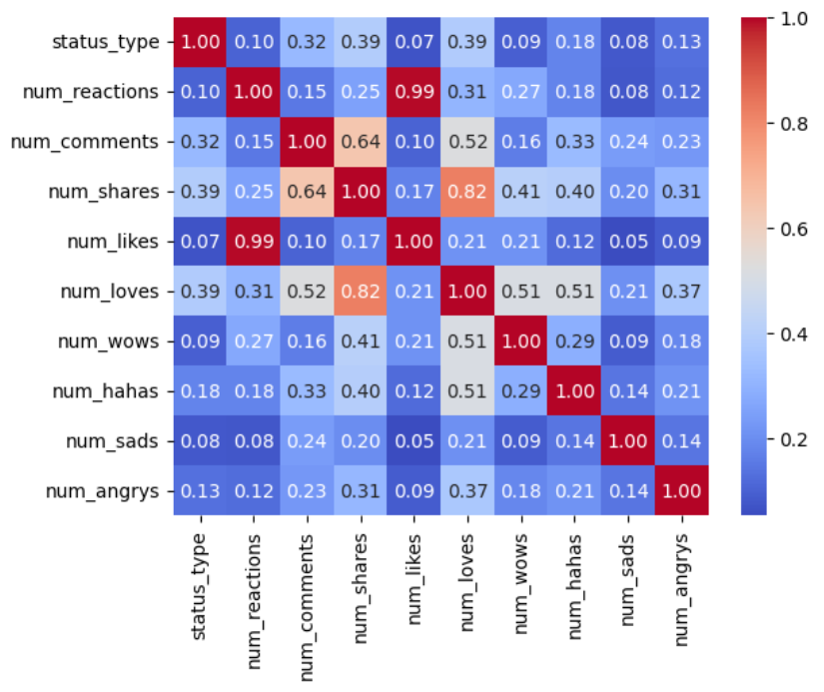
Q2. CoRRELATION BETWEEN ALL THE COLUMNS OF DATA SET
We have plotted this to help us know the dependence of columns on each other as it will help us choosing columns to plot for checking the results.
We can use num_comments and num_reactions as correlation index between them is 0.15 i.e. they are quite unrelated.

Slide 17
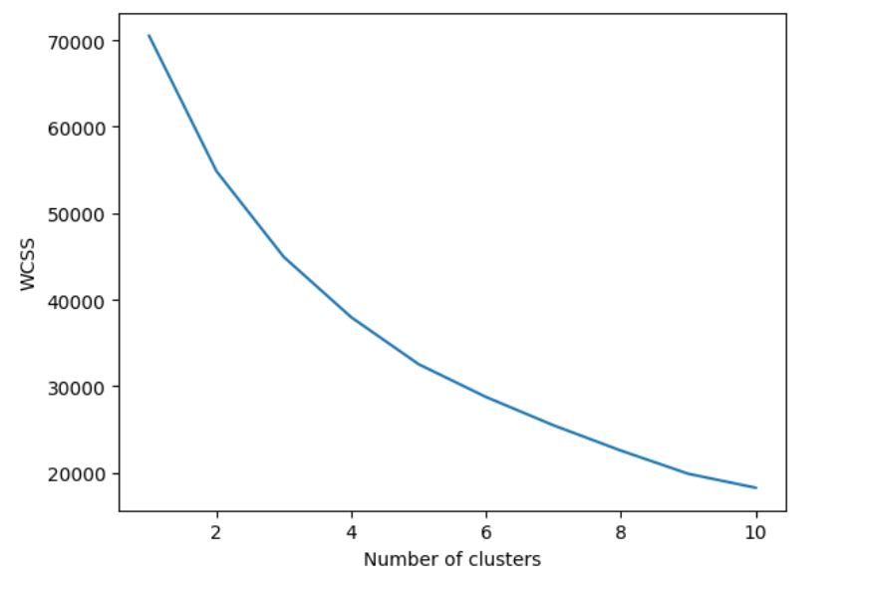
Q4. CALCULATING THE NUMBER OF CLUSTERS (USING ELBOW METHOD)
Here is the plot of WCSS v/s Number of Clusters .
We can clearly observe a kink at 3rd cluster forming an elbow.
Therefore required number of clusters is 3.

Slide 18
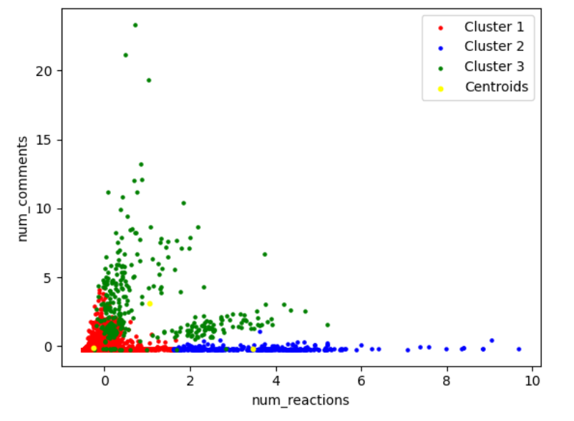
GRAPH REPRESENTING 3 CLUSTER FORMATION
Here we have plotted num_reactions v/s num_comments representing the three cluster formation.
Cluster-1(RED) represents posts having less-reactions and less-comments(basically the unpopular ones).
Cluster-2(BLUE) represents posts having very less comments but large number of reactions (posts not involving verbal interactions e.g. posting personal pictures).
Cluster-3(GREEN) represents posts having proportionate amount of number of reactions and comments (basically the popular ones).

Slide 19
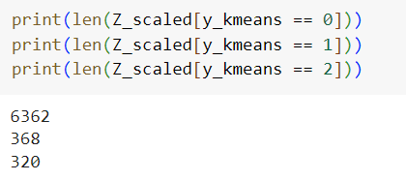
Q5. count of different types of posts in the dataset
We can clearly observe that number of different types of posts i.e. number of posts in different clusters are:
Cluster-1 : 6362 (unpopular posts)
Cluster-2 : 368 (reaction posts)
Cluster-3 : 320 (Popular posts)

Slide 20
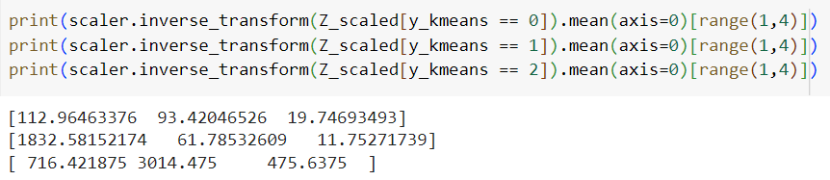
Q6. AVG OF ReACTIONS , SHARES AND COMMENTS IN EACH POSTS
We can clearly observe different averages of different types of posts :
Type-1 : num_reactions = 112.96 num_comments = 93.42 num_shares = 19.75
Type-2 : num_reactions = 1832.58 num_comments = 61.78 num_shares = 11.75
Type-3 : num_reactions = 716.42 num_comments = 3014.48 num_shares = 475.64

